Slide 1

US Public Transportation
Project 1 – Presentation
Group Twelve
Eric Huynh

Slide 2

Research Question
How can we enhance the relevance and ridership of public transportation in the United States?
Gross Domestic Production (GDP)
Density
Population
Cars per Household
Access to Cars
Unemployment Rate
Education
7. Highschool or higher
8. Bachelors or higher
2 / 10

Slide 3

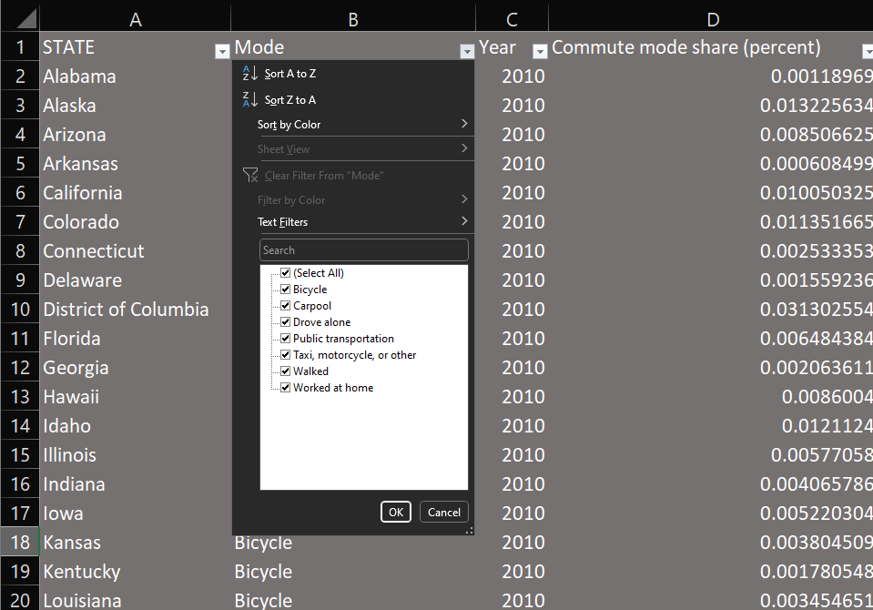
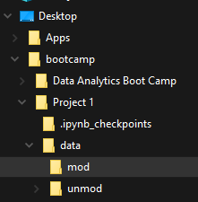
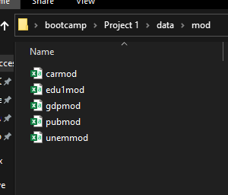
Data Extraction/Preprocessing
Unique Identifier
State
Alphabetized
Column Names
Acronyms
Capitalization
Missing States
“Puerto Rico”
“District of Columbia”
Renaming files
Consistency
Organization
Figure 3.1 “Uses Public Transportation (%)” .csv file data cleaning
Figure 3.2 File path and organization
Figure 3.3
Naming consistency
3 / 10

Slide 4

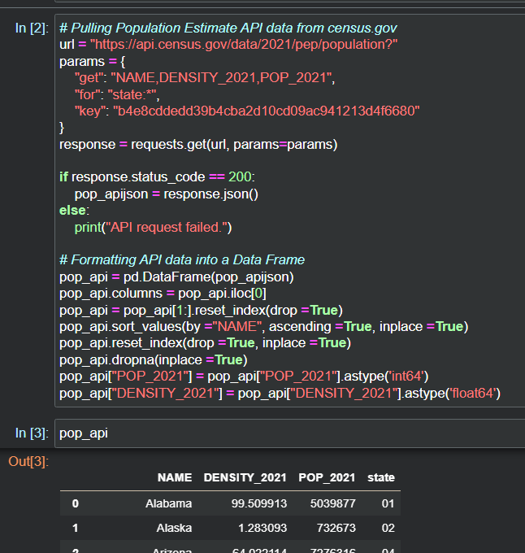
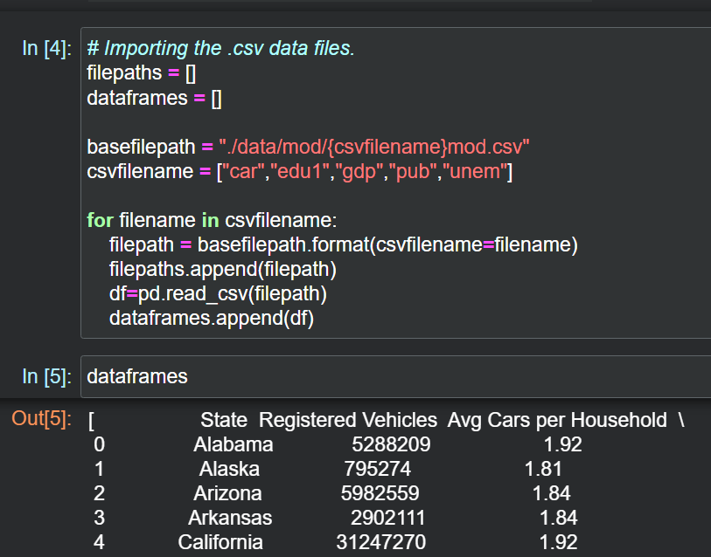
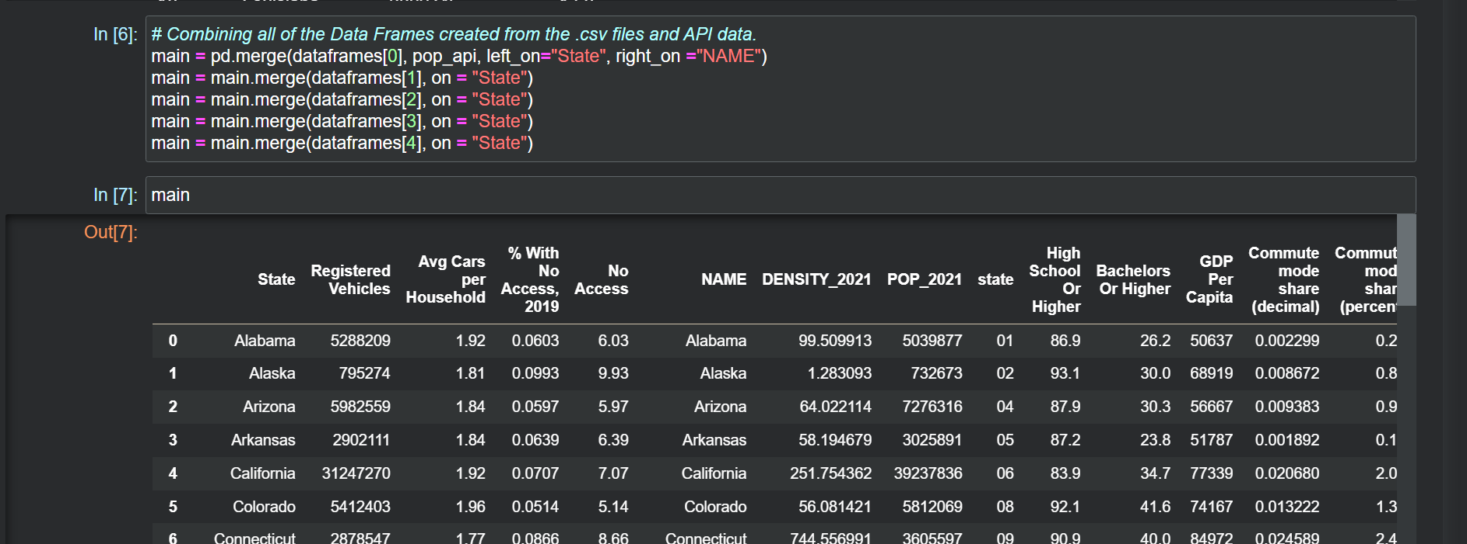
Data Import/Merge
Data preprocessing made writing the code cleaner.
Figure 4.1 A code pulling API data from Census.gov
Figure 4.2 A code to import the .csv files into
their respective data frames
Figure 4.3 Merging API data with all of the rest of the .csv data into one whole data frame
Costed me a day
4 / 10

Slide 5

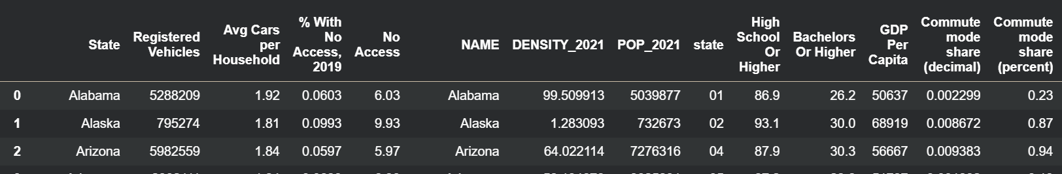
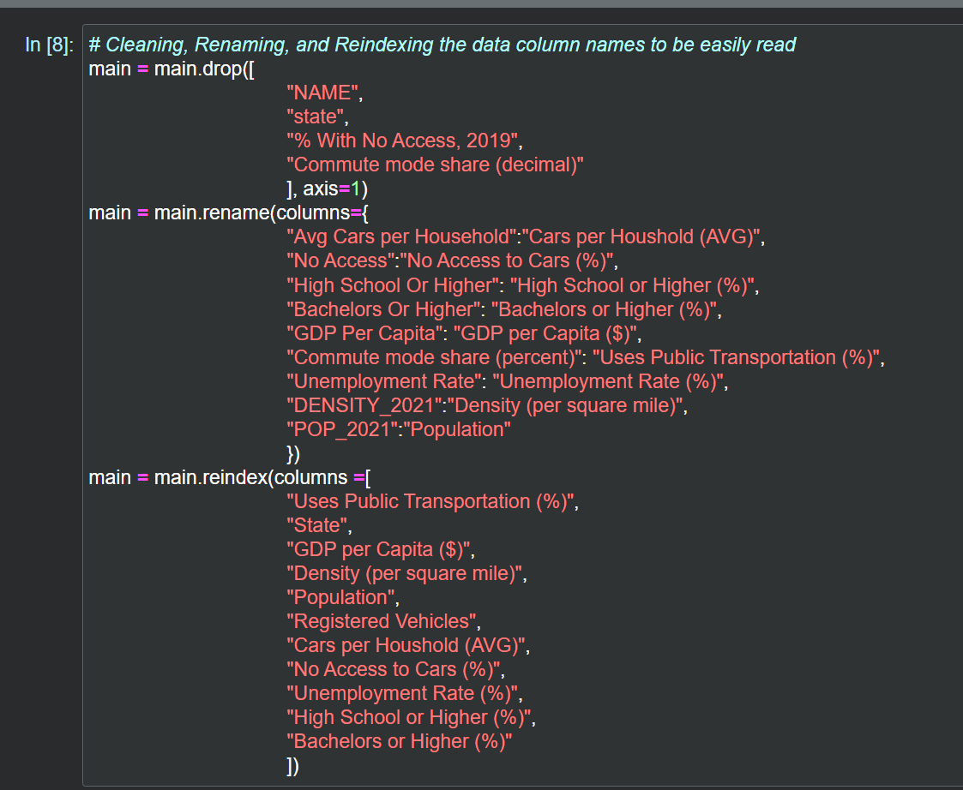
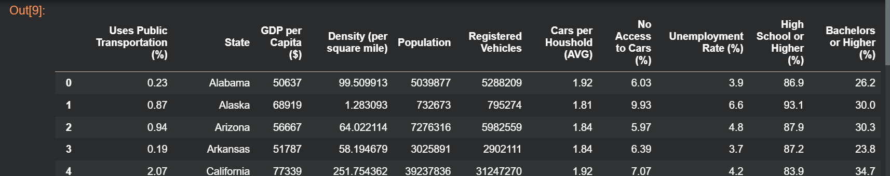
Data Manipulation/Cleaning
Figure 5.1 Merged data frame without data manipulation/cleaning
Figure 5.2 Code to manipulate/clean the “main” data frame
Figure 5.1 Final “main” data frame
5 / 10

Slide 6

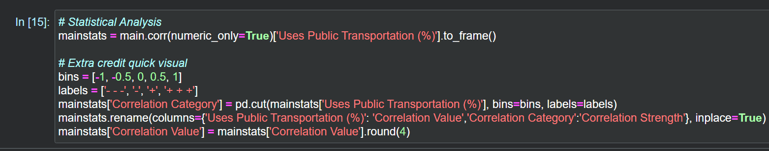
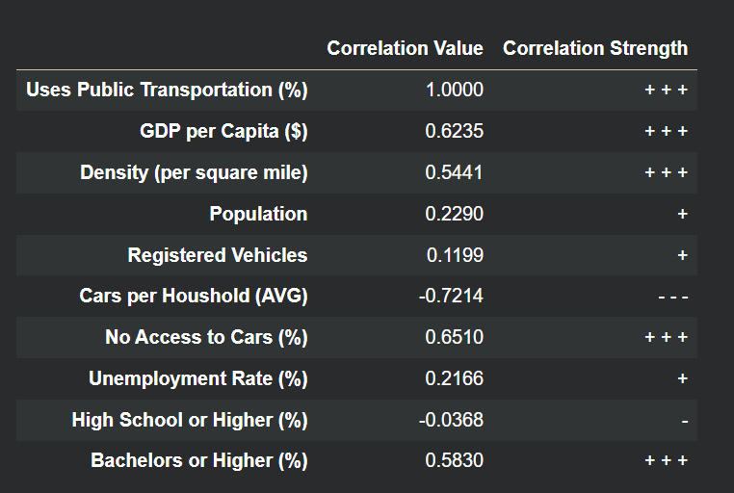
Statistical Analysis
Figure 6.1 The code written for the correlation value and correlation strength
Positive | Negative | No correlation
GDP Density No Access to Cars Bachelors | Cars per Household | Population Registered Vehicles Unemployment Rate Highschool
Figure 6.2 Correlation Value table of each variable compared to “Uses Public Transportation (%)”
Table 6.1 Out of the 9 variables, there are 4 positive correlation, 1 negative correlation, and 4 that are not worth mentioning.
6 / 10

Slide 7

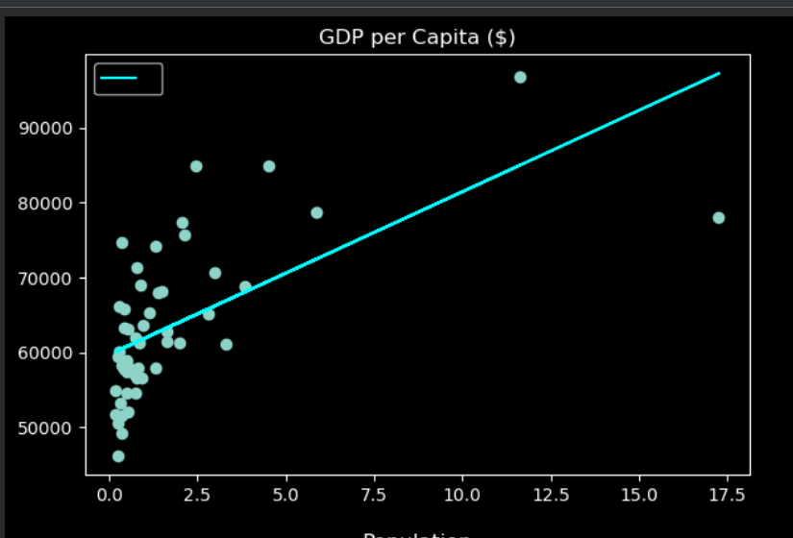
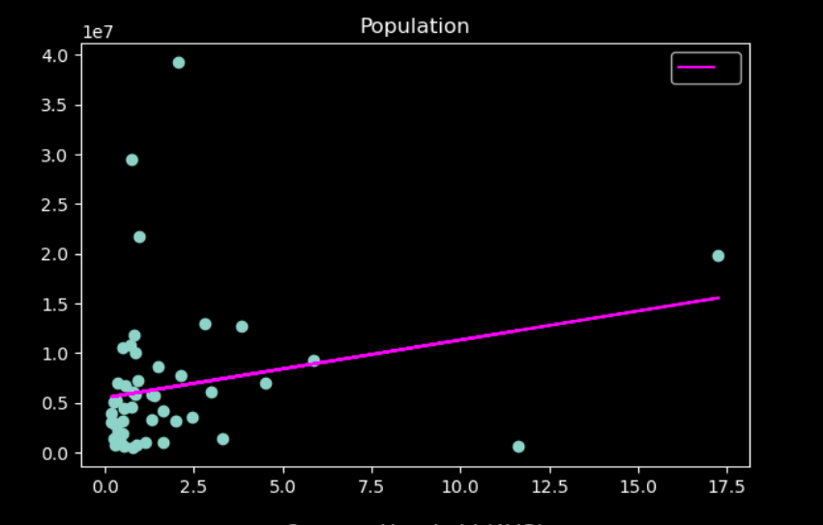
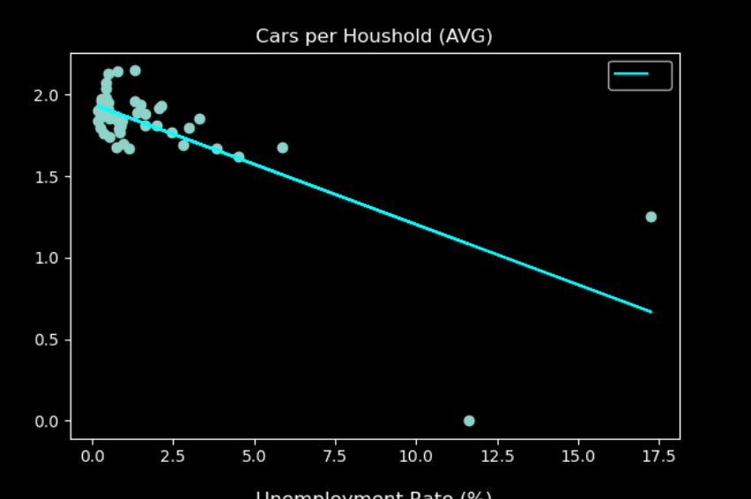
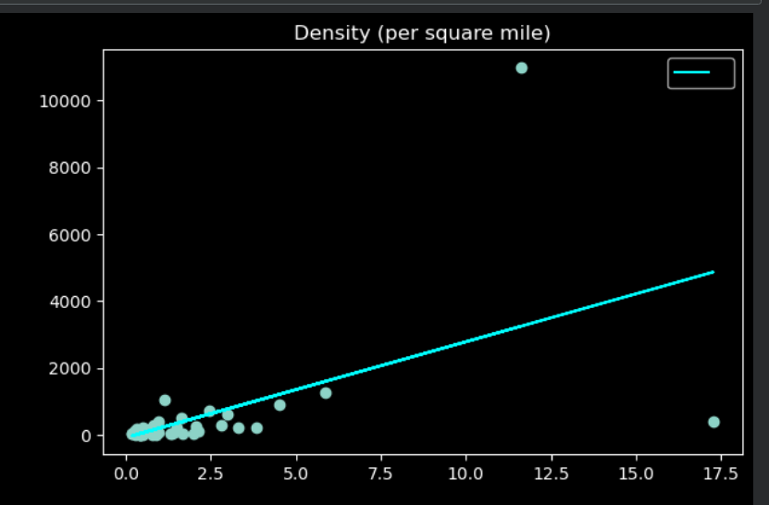
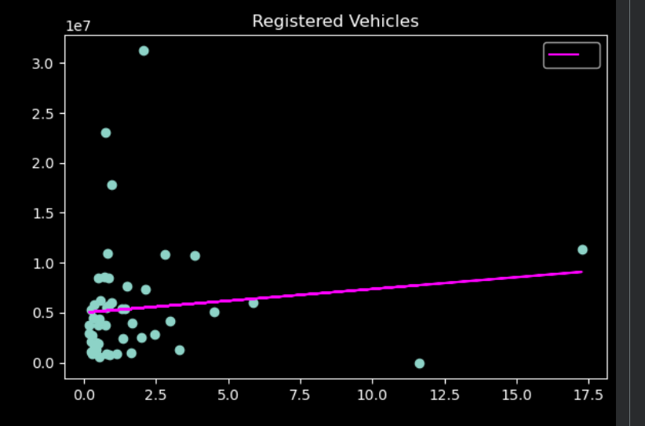
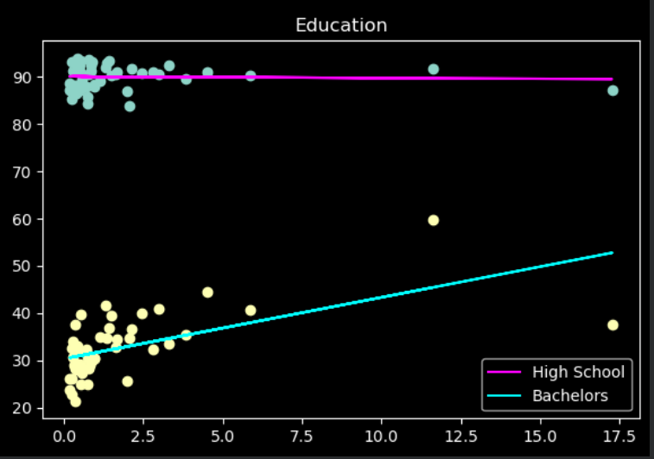
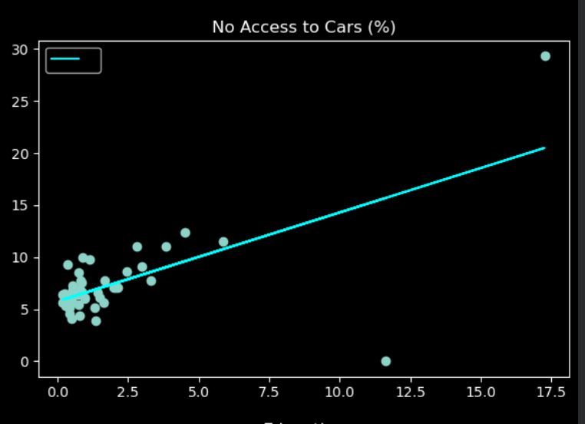
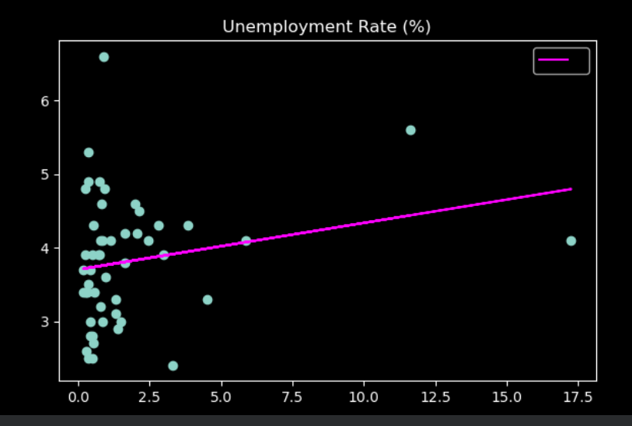
Data Visualization
Graph 7.1 GDP
Graph 7.6 Population
Graph 7.4 Cars per Household
Graph 7.2 Density
Graph 7.7 Register Vehicles
Graph 7.5 Education (Highschool and Bachelors)
Graph 7.8 Unemployment Rate
7 / 10
Graph 7.3 No Access to Cars

Slide 8

Key Findings and Insights
Gross Domestic Production (+)
If there are public transportation there would be an increase in job opportunities for those who cannot drive or afford a car due to socioeconomic reasons.
Density (+)
If there are dense areas, there may be lots of congestion so public transportation may be ideal for some people.
No Access to Cars (+)
If there is no access to cars, the public transportation is the other type of method to get around the US especially because of the US transportation infrastructure.
Bachelor’s or Higher (+)
Resourceful
Socioeconomic factors
Cars per Household ( - )
Supports the need of public transportation decreases if there cars are available
“Correlation does not imply causation.”
8 / 10

Slide 9

Limitations or Improvements
Third Variable
Instead of comparing two variables
Data Aggregation
Compare cities next time
Timeframe
Compare across the years
Complex interaction
Social economic factors, education, density, and etc.
Add more variables
Environmental Air Quality Index
9 / 10

Slide 10

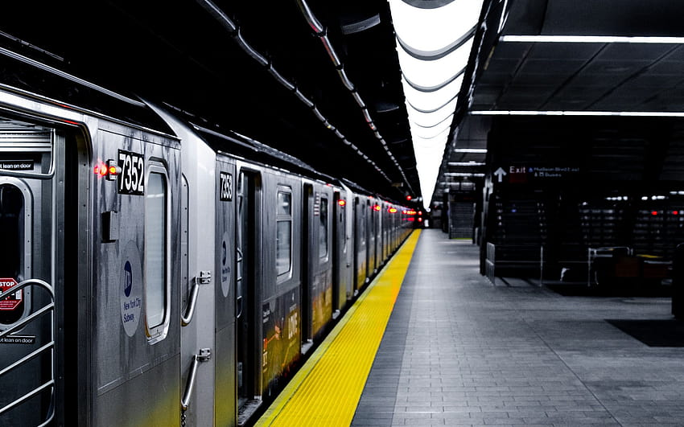
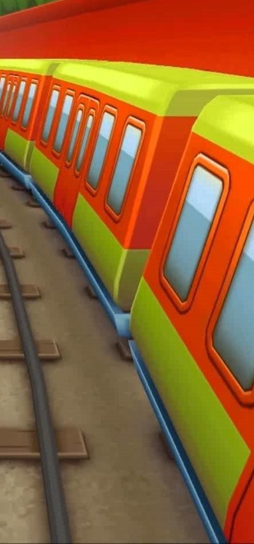
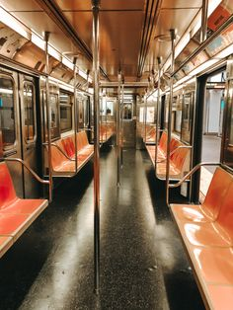
End
Resources
National Transit Database
Bureau of Transportation Statistics
Census Transportation Planning Products
Census.gov
2023 World Population Review
Iowa Community Indicator Program
Bureau of Labor Statistics
10 / 10

